Slide 1

Medical Diagnosis Using Data Mining
Team:
Huzaifa Vakil
Sohel Tharani
Zain Momin
Asad Siddiqui
Under the guidance of Dr. Anupam Choudhary
Session 2018-2019

Slide 2
Abstract
Data mining is the method of discovering patterns in huge datasets. These patterns are then used to make decisions and also to find future trends.
Data mining techniques have been widely used in industries such as finance, retail and telecommunication.
However, data mining techniques have not been as widely used in clinical decision support systems for prediction and diagnosis of various diseases.
There are huge amounts of medical data that has just been stored hospital and clinic databases that aren’t being used.
Thus, the reason we have proposed this system is to find a way to create trends between stored data and to use these trends to help medical professions make a diagnosis in an efficient, quick and accurate manner.

Slide 3
Aim
Medical Diagnosis Using Data Mining and to identify the most important risk factors based on the classification rules to be extracted.
This will explain how well data mining and Neuro-Genetic system are integrated and also describes the datasets undertaken for this work.

Slide 4
Objective
It helps decision makers utilize data and models in order to identify problems.
It solves problems and makes decisions.
It incorporates both data and models and they are designed to assist decision makers in semi-structured and unstructured decision making processes.
It improves effectiveness, rather than the efficiency of decisions.

Slide 5
MLFFN
A neural network consists of layers of interconnected artificial neurons.
A multilayer feed forward neural network consists of a layer of input units, one or more layers of hidden units, and one output layer of units. A neural network that has no hidden units is called a Perceptron.
However, a Perceptron can only represent linear functions, so it isn’t powerful enough for the kinds of applications to be solved

Slide 6
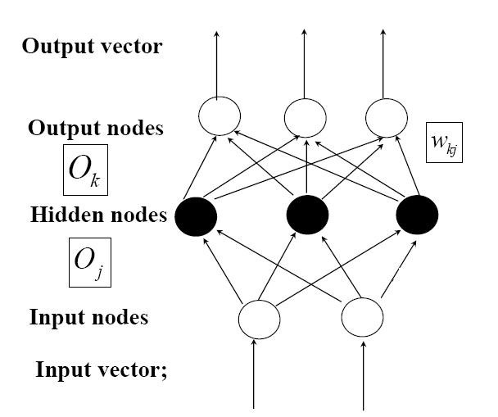
Structure of MLFFN

Slide 7
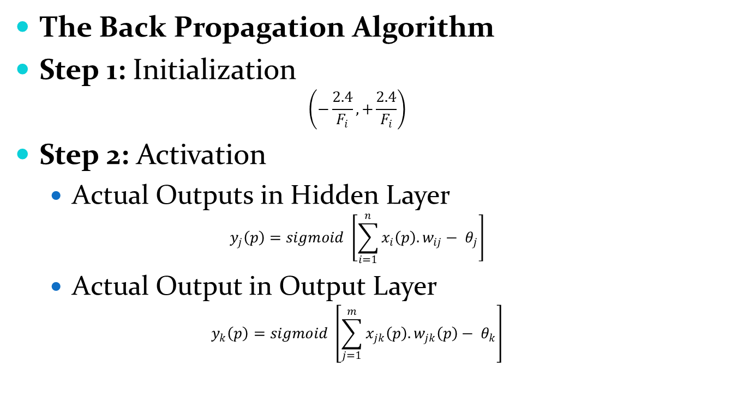
MLFFN Training & Propagation
The Back Propagation Algorithm
Step 1: Initialization
$$\left(−\frac{2.4}{F_{i}}, +\frac{2.4}{F_{i}}\right)$$
Step 2: Activation
Actual Outputs in Hidden Layer
$$y_{j}\left(p\right)=sigmoid \left[\sum_{i=1}^{n}{x_{i}\left(p\right). w_{ij}− θ_{j}}\right]$$
Actual Output in Output Layer
$$y_{k}\left(p\right)=sigmoid \left[\sum_{j=1}^{m}{x_{jk}\left(p\right). w_{jk}\left(p\right)− θ_{k}}\right]$$

Slide 8
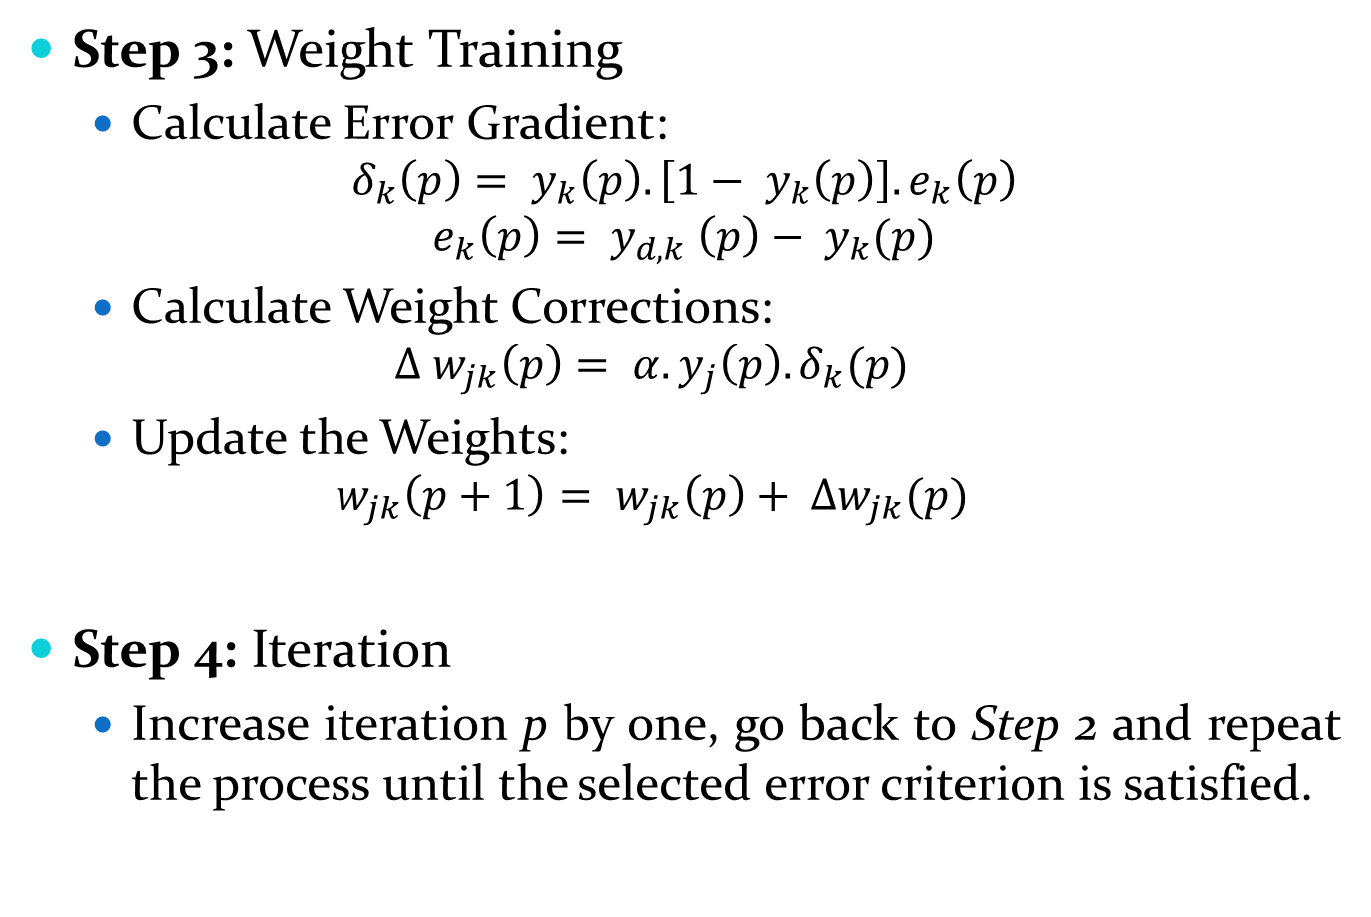
Step 3: Weight Training
Calculate Error Gradient:
$$δ_{k}\left(p\right)= y_{k}\left(p\right).\left[1− y_{k}\left(p\right)\right].e_{k}\left(p\right)$$
$$e_{k}\left(p\right)= y_{d, k} \left(p\right)− y_{k}(p)$$
Calculate Weight Corrections:
$$∆ w_{jk}\left(p\right)= α.y_{j}\left(p\right).δ_{k}(p)$$
Update the Weights:
$$w_{jk}\left(p+1\right)= w_{jk}\left(p\right)+ ∆w_{jk}(p)$$
Step 4: Iteration
Increase iteration p by one, go back to Step 2 and repeat the process until the selected error criterion is satisfied.

Slide 9
Genetic Algorithm
Genetic Algorithm are Selection, Cross over, Mutation, Accepting.
Select two parents’ chromosomes from a population according to their fitness.
Crossover with a crossover probability crossover of a parent to form new offspring is the exact copy of parents.
Mutation with a mutation probability mutates new offspring at each locus.
Accepting place new offspring in the new population.

Slide 10
Proposed Algorithm
In the first step the heart disease consists of dataset which is collected from the medical institute and Initialize the process.
Extract the risk factors of patient’s details which consists of patient information, patient history, Gene diagnosis disease database which contains the symptoms of Heart disease.
Selection process start with assigning the weight randomly to each attribute.
Each attribute is given in the hidden layer of neural network and it will start process of training.

Slide 11
Compare the actual and desired output.
Calculate the error in each neuron.
Propagates this error by using the Backpropagation algorithm.
If the training process is satisfy, then it will go to the exact heart attack prediction of patients.
Otherwise it will be go to genetic algorithm adjust the weight and return to the step 3.
Finally, the result of patients will be predicting the heart attack via affect patients or not affect the patient.

Slide 12
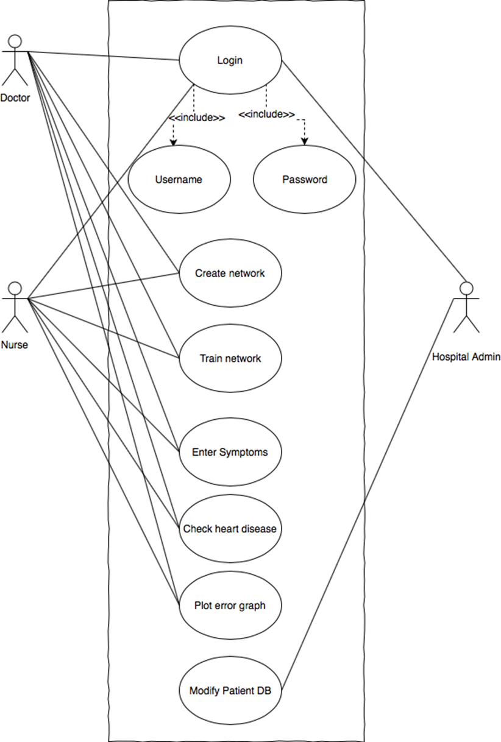
Use Case Diagram

Slide 13
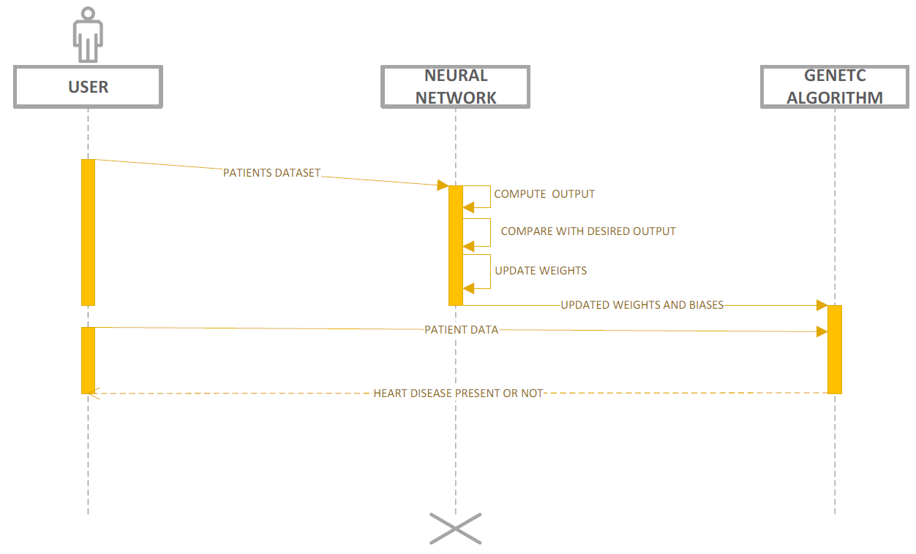
Sequence Diagram

Slide 14
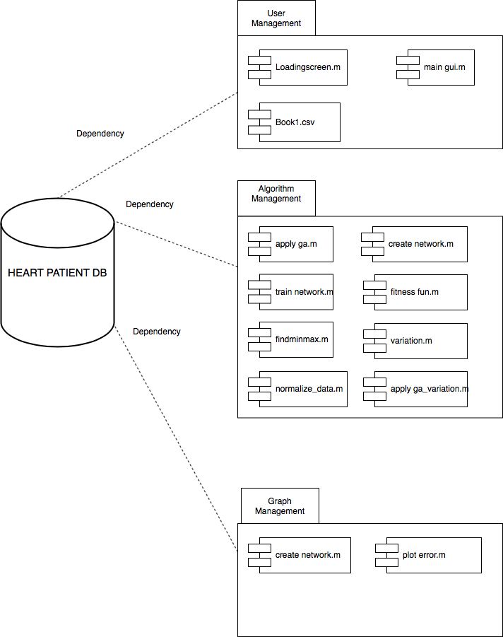
Component Diagram

Slide 15
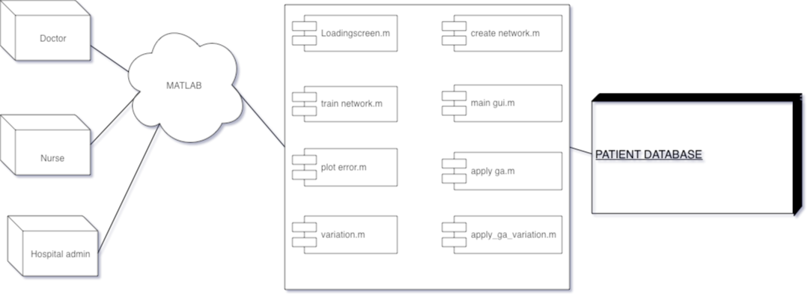
Deployment Diagram

Slide 16
Limitations
Our System is not 100% accurate, so there might be a case where the system can predict wrong.
Also, the final decision should be made by doctors.
Parameters to be covered when making a prediction are vast and is a challenging task.
Acquiring data sets is a challenge.

Slide 17
Future Scope
If our project is implemented in large-industry datasets, it can be diversified into looking for the symptoms of the disease or the causation of that specific pattern making use of various machine learning algorithms. Our project may become the base of diversification, and to facilitate this acceleration of development, it is necessary to have the basics of machine learning model.
Our project is focused on the prediction of one disease. It can be used to have predictions of different diseases other than heart disease which our project proposes.

Slide 18
Publication-I
The Paper ”MEDICAL DIAGNOSIS USING DATA MINING” have been submitted and accepted with Uniqueness of 76% in International Journal of Emerging Technologies and Innovative Research (JETIR), Registration ID: JETIR90293.
Authors: Huzaifa Vakil, Zain Momin, Asad Siddiqui and Sohel Tharani.
Guide: Dr. Anupam Choudhary

Slide 19
Publication-II
The Paper ”HEART DISEASE PREDICTION (MEDICAL DIAGNOSIS) USING DATA MINING” have been submitted in International Conference on Global Technology Initiatives (ICGTI).
Paper Publication In-Progress
Authors: Sohel Tharani, Asad Siddiqui, Huzaifa Vakil & Zain Momin
Guide: Dr. Anupam Choudhary

Slide 20
THANK YOU

